Slide 1
OIL PRICE PREDICTION
Team 1

Slide 2
Mentors
Dhanyapriya Somasundaram
Kartik
Team Members
Ajeeth Kumar
Himmat Singh
Priya Pareek
Shubham Patidar

Slide 3
Objective:
Oil is a product that goes completely in a different direction for a single market event as the oil prices are rarely based on real-time data, instead, it is driven by externalities making our attempt to forecast it even more challenging
As the economy will be highly affected by oil prices our model will help to understand the pattern in prices to help the customers and businesses to make smart decisions.

Slide 4
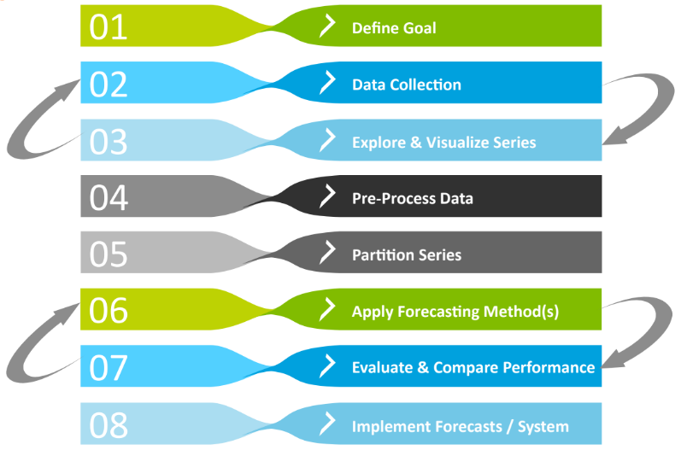
Forecasting Model Building Strategy

Slide 5
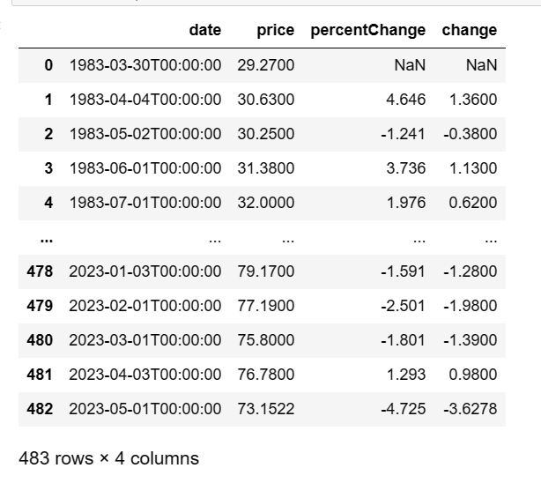
Dataset :
We extracted Dataset from Kaggle.
Loading The Dataset
After Loading the dataset checking for Null Values.
Sum of null Values.
Duplicate Values.
Then sum of duplicate Values.

Slide 6
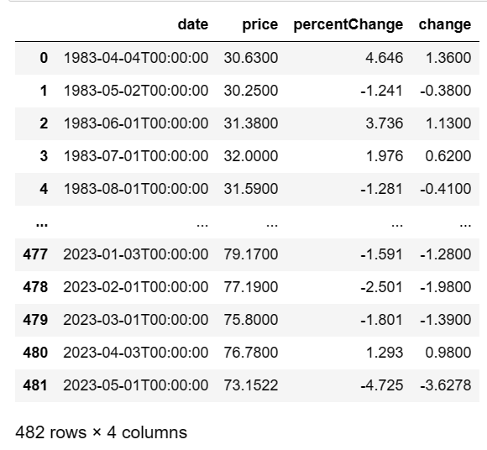
Data Cleaning
In this part there is no duplicate values then we only removed the null values.

Slide 7
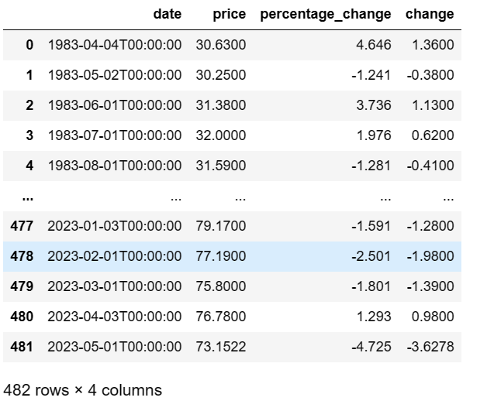
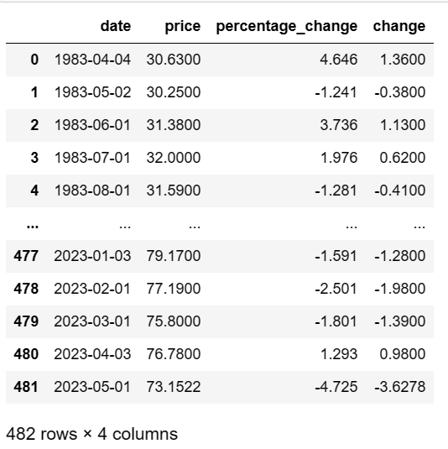
Feature Engineering
Converting Columns and date time

Slide 8
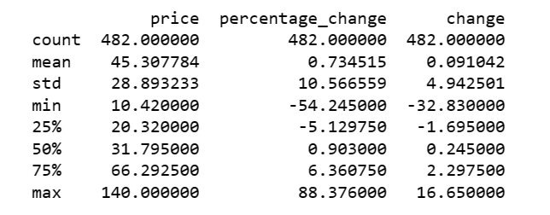
EDA
In EDA there are 483 Rows x 4 Columns
In Feature Engineering there are 482 Rows x 4 Columns
Duplicate values 0
Describing the data:

Slide 9
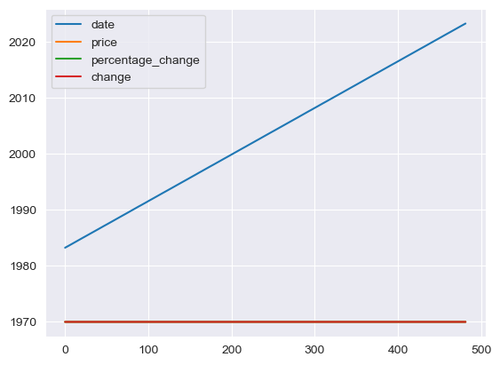
Data Visualization
This is the oil price data distribution plot b/w all the 4 features(date, price, change, percentage change).

Slide 10
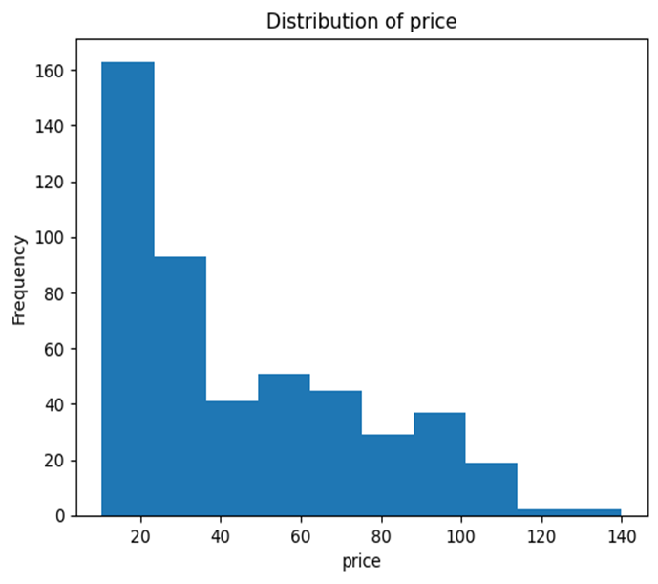
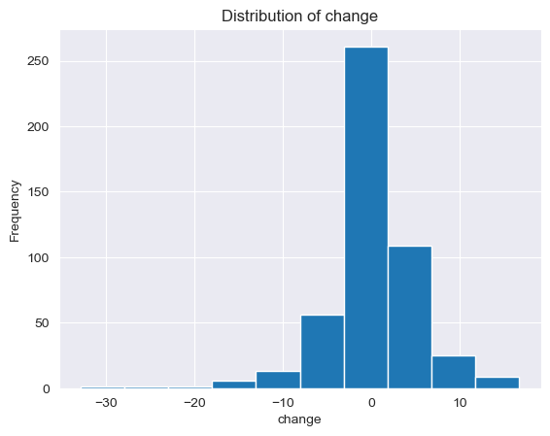
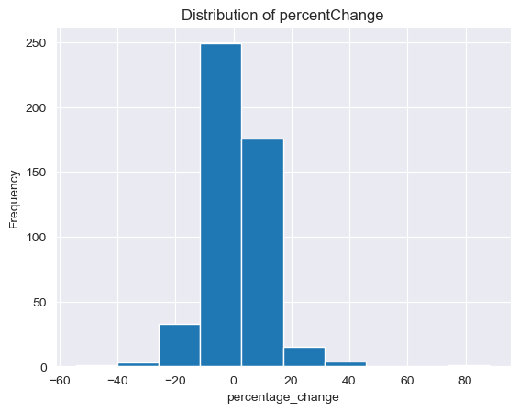
Count Plots
These are distribution plots of price, change and percentage change.
And in price distribution plot ,the data is right skewed data.

Slide 11
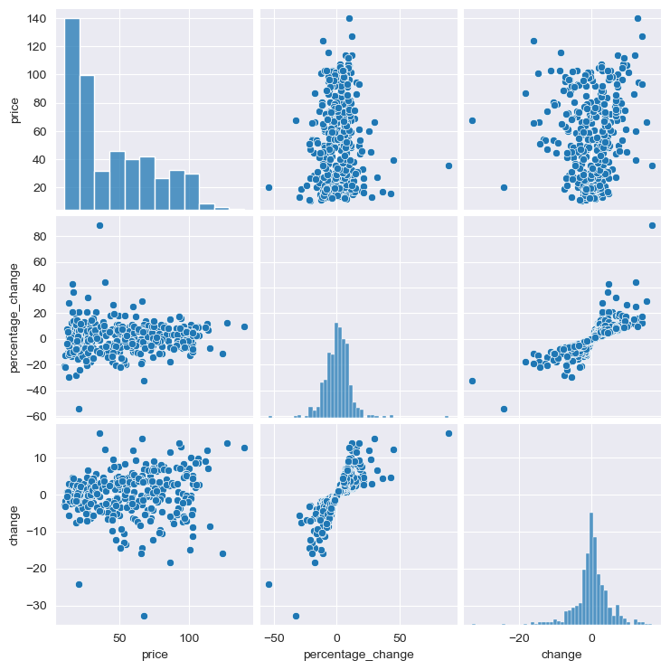
Pair Plot

Slide 12
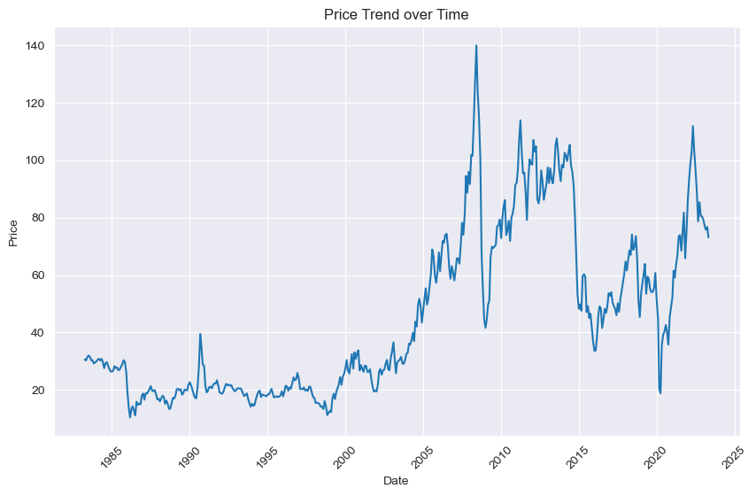
Visualizing Price Over Time

Slide 13
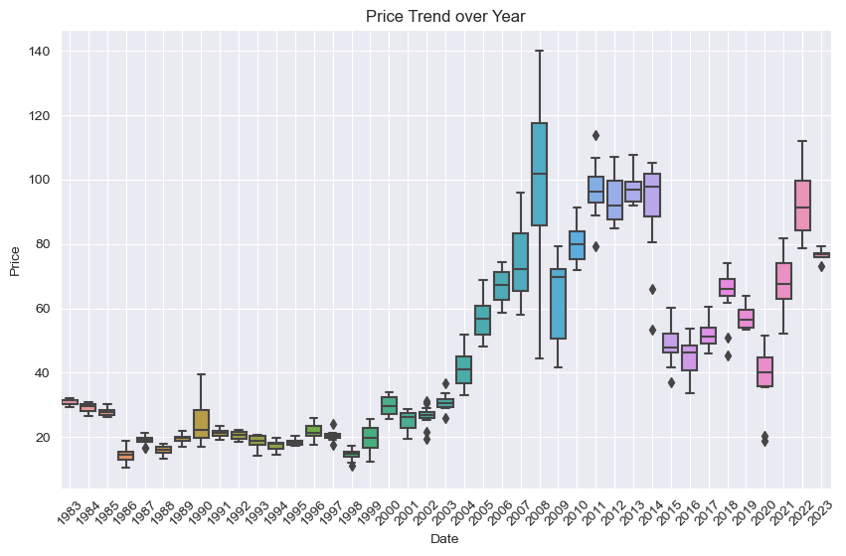
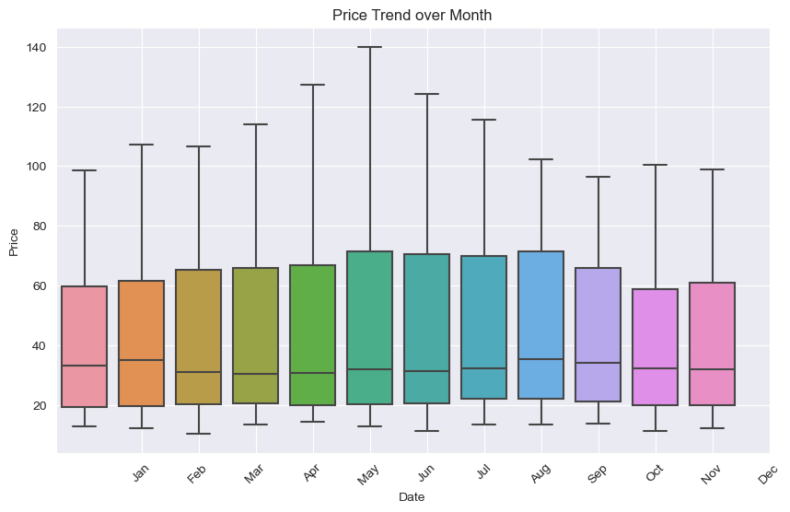

Slide 14
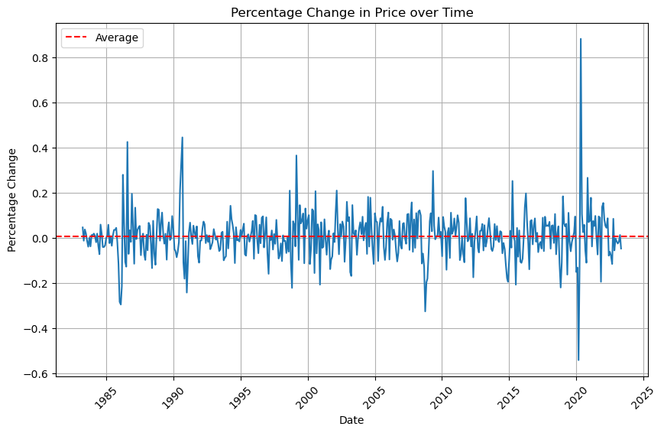
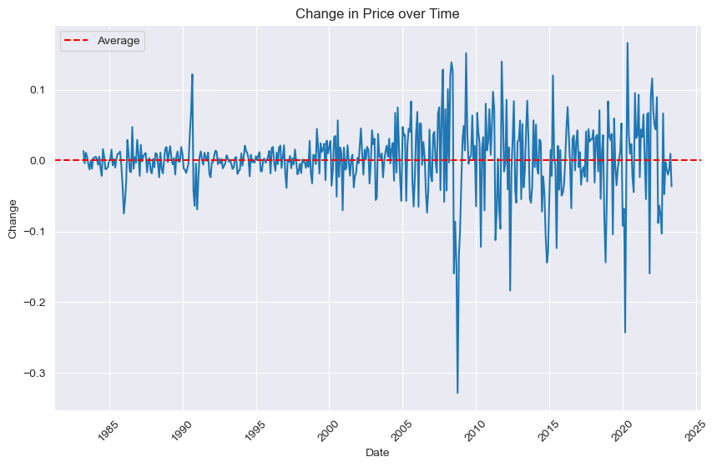
Analysing Percentage Changes
Analysing Actual Change

Slide 15
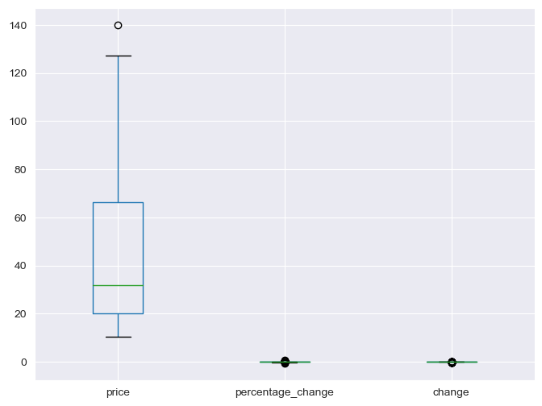
Outlier Detection

Slide 16
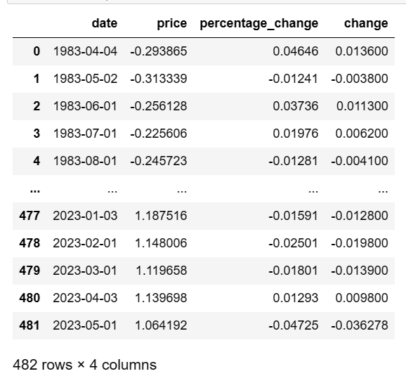
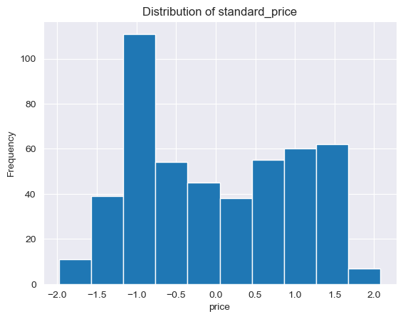
Pre-Processing The Data
Plotting The Distribution Of Standard Price

Slide 17
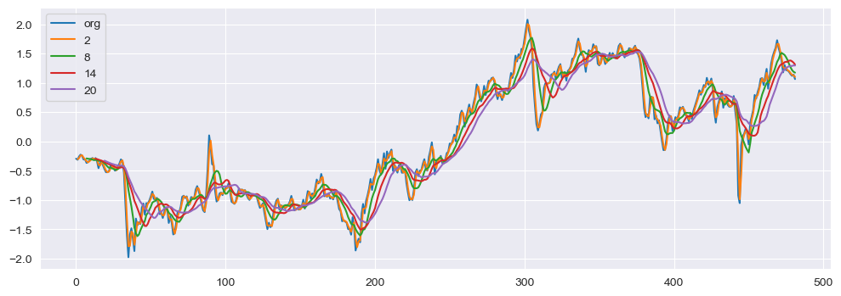
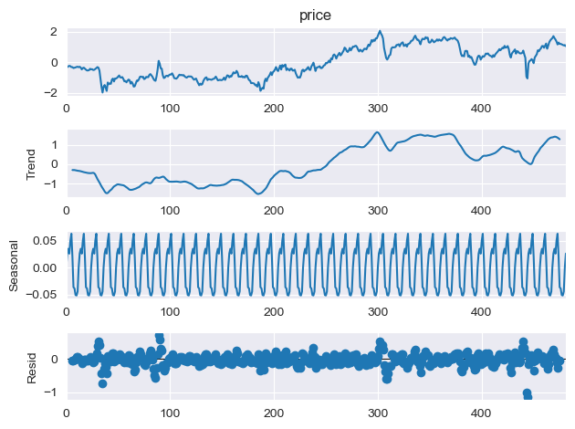
Moving Average
Time Series Decomposition Plot

Slide 18
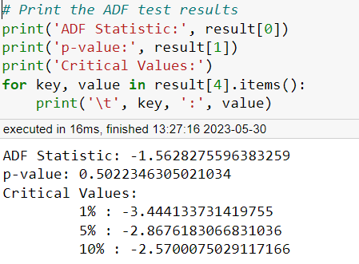
Checking For Stationarity
Here we checked stationarity of data using Dickey Fuller test .
We can see the P value of the data is greater than significant level(0.05).
Then we can say that the data is non stationary.

Slide 19
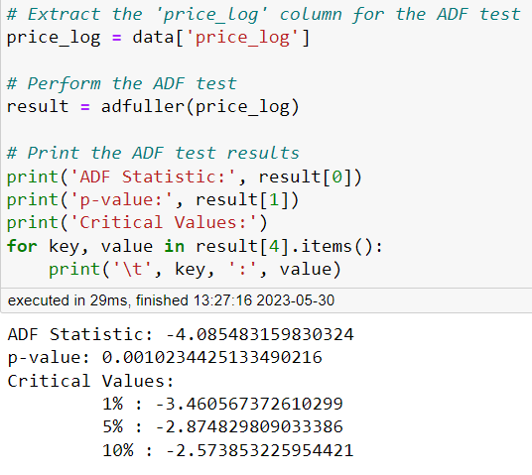
Methods implemented to remove non stationary
Again check from Dickey Fuller test
1) Differencing
2)Logarithmic Transformation
After logarithmic transformation our time series data converted into stationary.
Here the P value of data is less than significant level(0.05)
Then we can say that the time series data is converted into stationary

Slide 20
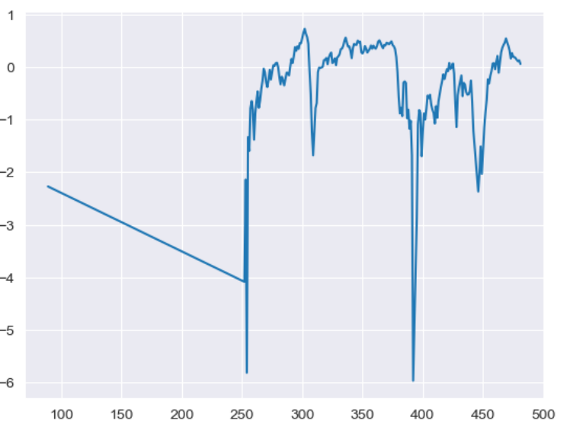
Visualizing the stationary of data

Slide 21
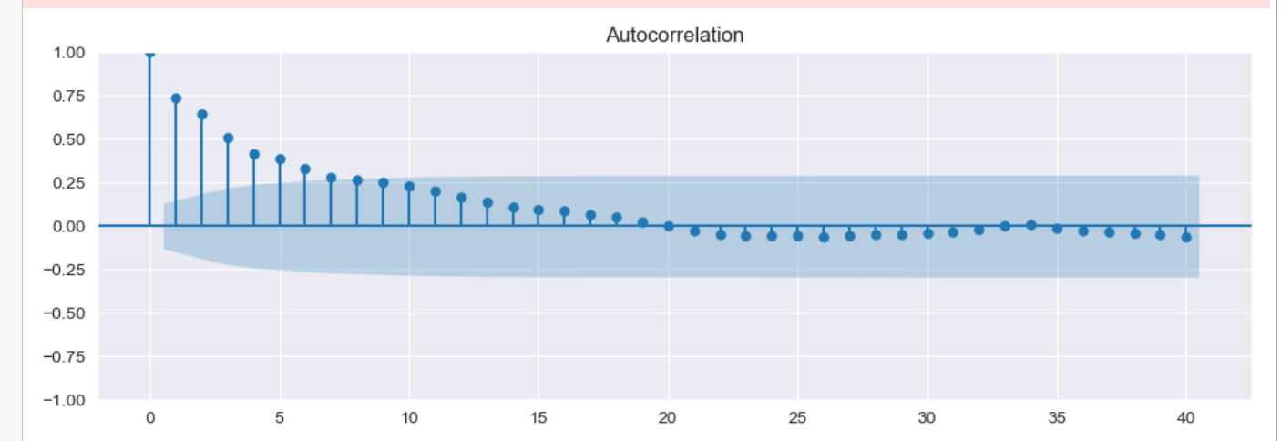
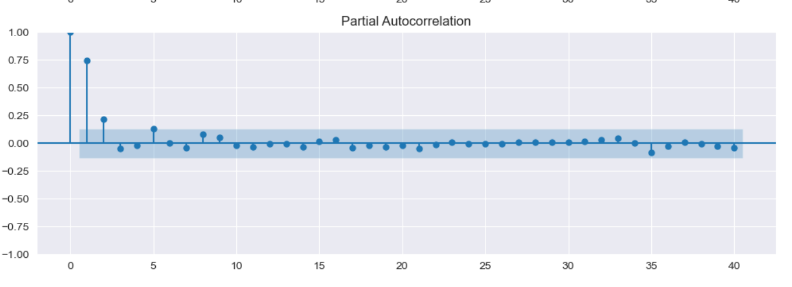
Autocorrelation plot
Partial autocorrelation plot

Slide 22
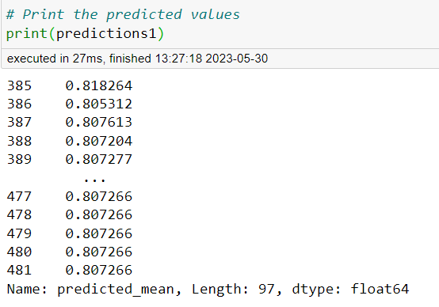
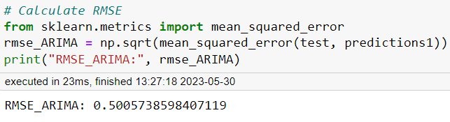
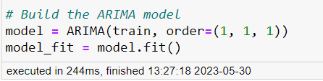
Model Building
Predictions:
RMSE value
1)ARIMA Model
Deciding Parameters:
Auto-Regressive term (p)
Moving Average term (q)
Differencing order term (d)
Splitting the data into train and test sets
training data = 80%
testing data = 20%
ARIMA model building :
p = 1
q = 1
d = 1

Slide 23
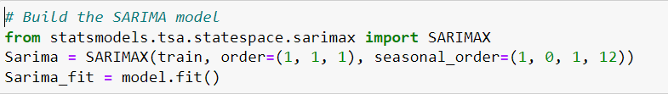
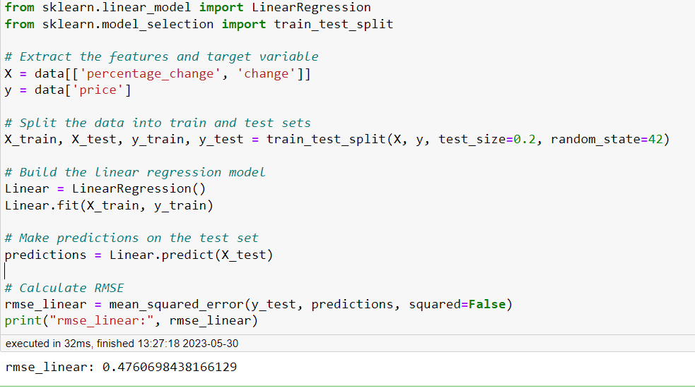
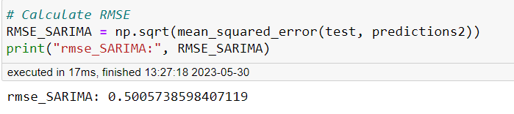
2) SARIMA Model
3) Linear Model
RMSE value for SARIMA

Slide 24
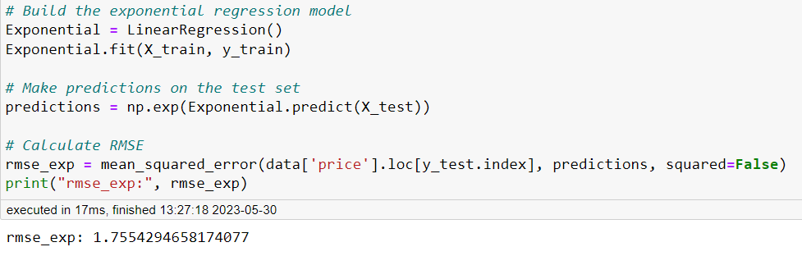
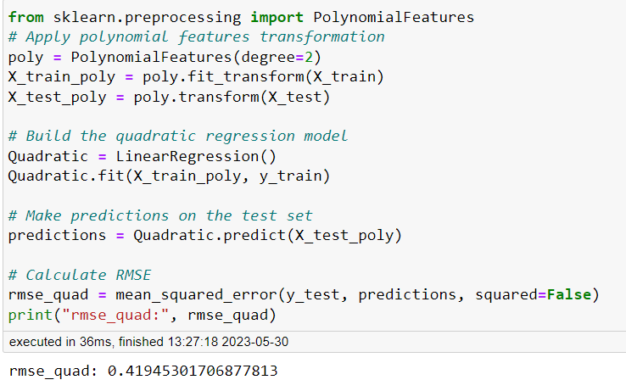
4)Exponential Model
5)Quadratic Model

Slide 25
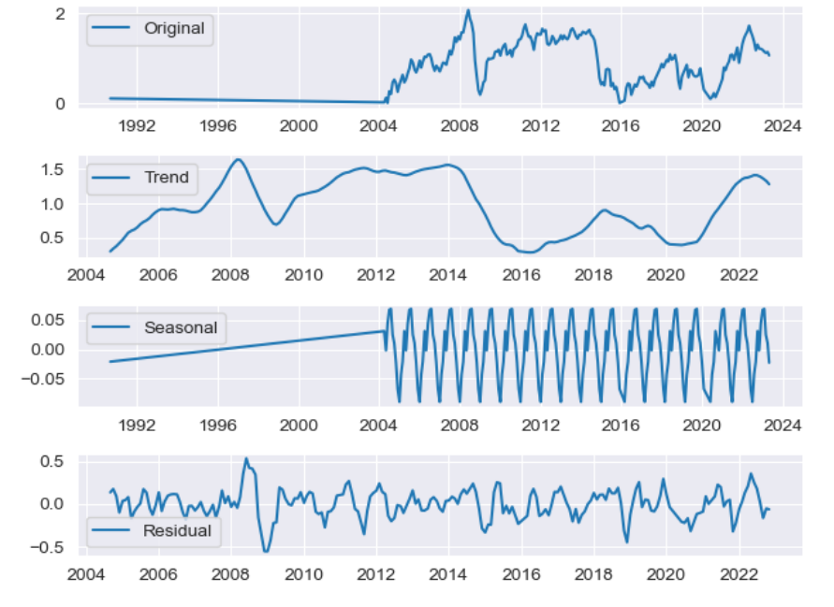
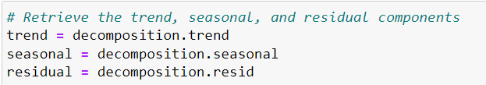
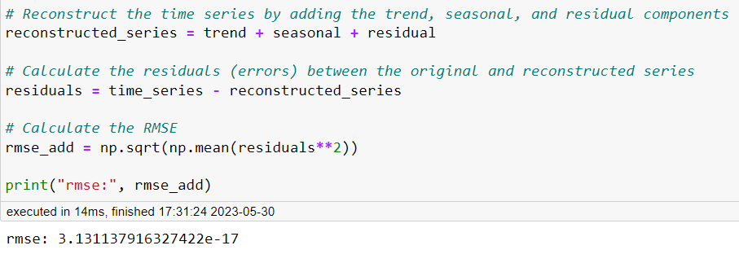
6)Additive seasonal Model
Visualize the components
RMSE value

Slide 26
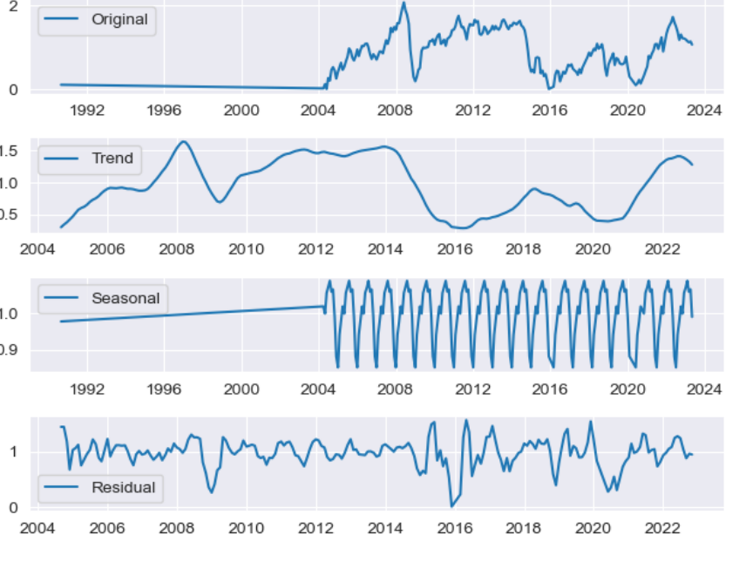
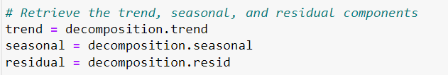
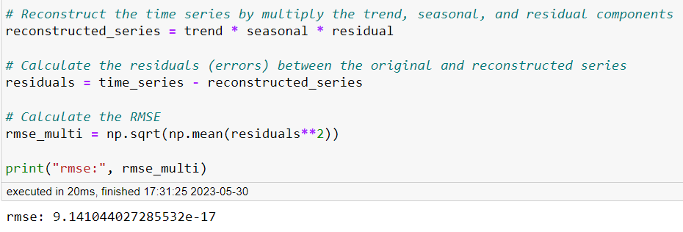
7) Multiplicative seasonal Model
Visualize the components
RMSE value

Slide 27
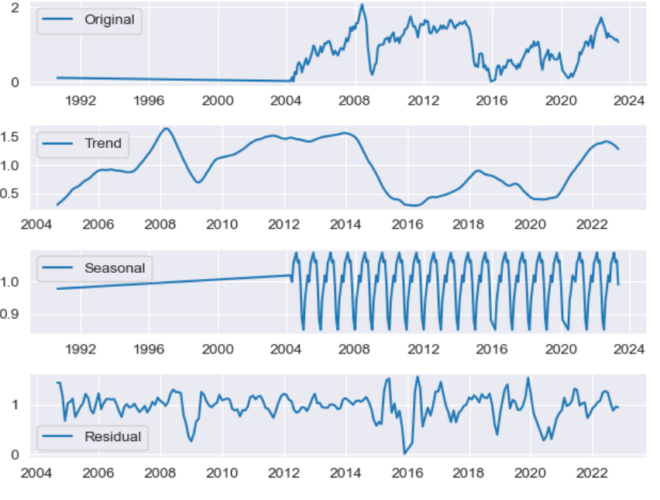
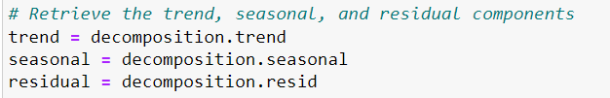
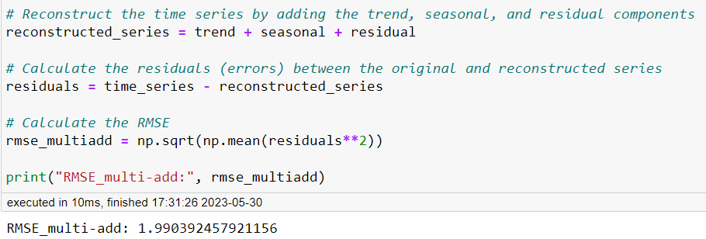
8) Multiplicative additive seasonal Model
Visualize the components
RMSE value

Slide 28

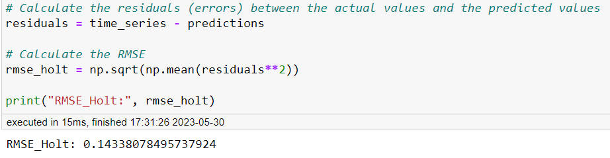
9) Holt Model
RMSE value

Slide 29
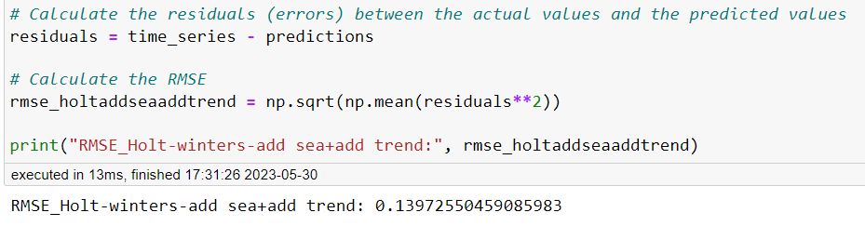
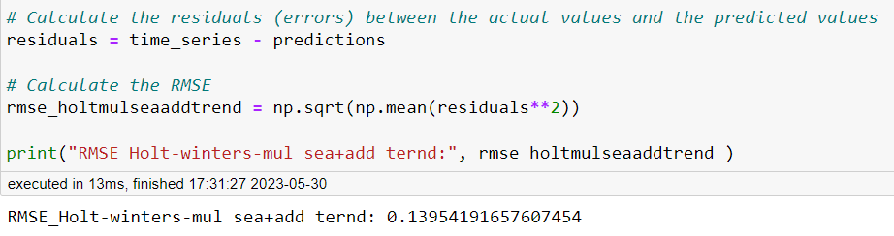
10) Holt-Winters Exponential Smoothing model with additive seasonality and additive trend
11) Holt-Winters Exponential Smoothing model with multiplicative seasonality and additive trend
RMSE value
RMSE value

Slide 30
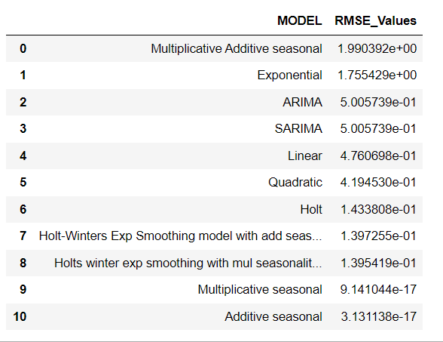
Model Evaluation
Here we can see that the additive seasonal model is having less RMSE value comparison to other models

Slide 31
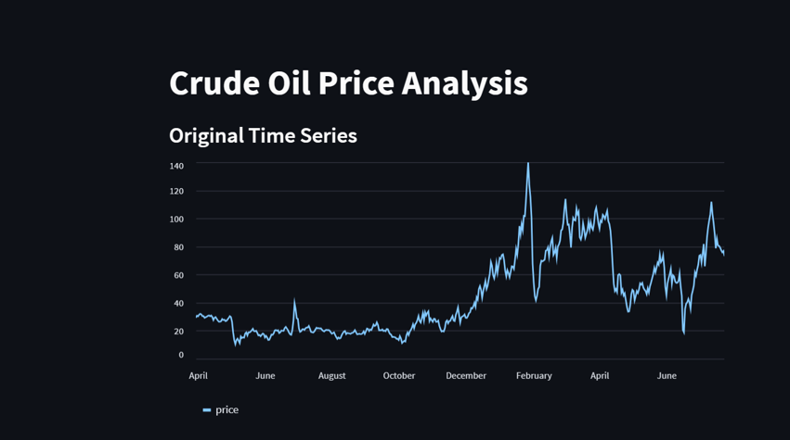
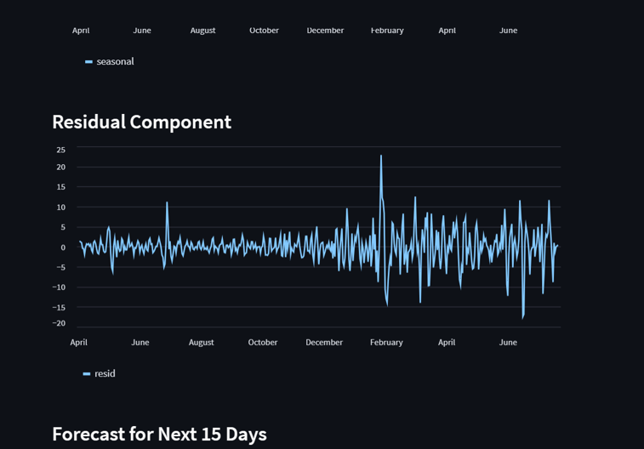
ARIMA model selected for Deployment

Slide 32
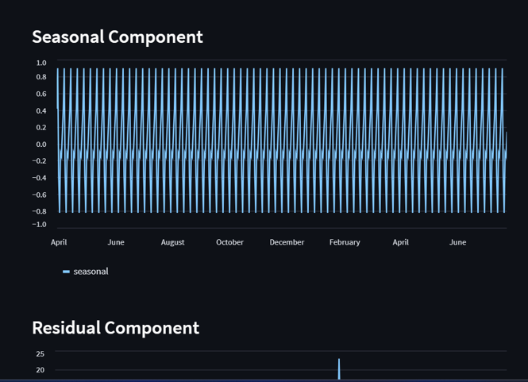


Slide 33



Slide 34
Challenges Faced During Project
fluctuations in Price graph causes variation in prediction.
Data set: The data set was not contain day wise data so if day wise data also available model would have been performed well with more data.
Data was not in the form standardization , outliers were present in the data.
Data was non stationary so we couldn’t build data driven models easily.

Slide 35
Overcome those challenges
Created data as day wise using pandas datetime function.
Converted data into standard form using StandardScaler.
Removed non stationarity from the data using log transformation for performed data driven models.

Slide 36


